Slide 1


CO1035: Game concepts
Lecture 4b - collisions

Slide 2
Lecture’s objectives
Describe collision detection
Explain the benefits and drawbacks of using bounding volumes
Implement the following collision detection approaches:
    point-to-point
    point-to-sphere
    sphere-to-sphere
    point-to-box
    sphere to box
Outline a simple collision detection and resolution algorithm

Slide 3
context
Part 1: Math Recall
Part 2: Collisions in video games
Part 3: Types of Collision Detection
Part 4: Collision Resolution

Slide 4
Part 1:
Math Recall

Slide 5
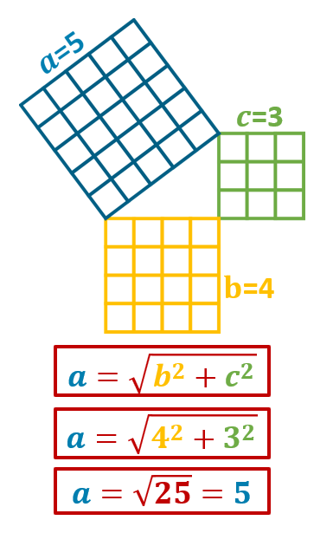
Recall: right-angle triangles
Right-angle triangles are the triangles in which one of their angles is equal to 90 degrees.
One of the properties of right-angle triangles is Pythagoras’ Theorem
Pythagoras’ Theorem states that the length of a right-angled triangle is equal to the square root of the sum of the squares of the other two sides.
The longest side of the right-angle triangle is called the hypotenuse.

Slide 6
RECALL:
VECTORS BETWEEN TWO POINTS
The vector V going from point P₁ to P₂ can be calculated by subtracting P₁ from P₂ (i.e. P₂ – P₁):
  subtract the x values to produce one new x;
  subtract the y values to produce one new y;
  subtract the z values to produce one new z.
Example: The vector V from
P1 (10, 20, 5) to P2 (30, 30, 30) is:
= V (x2 – x1, y2 – y1, z2 – z1)
= V (30 – 10, 30 – 20, 30 - 5)
= V (20, 10, 25)
Example: The vector V from
P1 (x1, y1, z1) to P2 (x2, y2, z2) is:
V (x2 – x1, y2 – y1, z2 – z1)

Slide 7

RECALL:
LENGTH OF A VECTOR
If we have a vector V(x, y, z), then we can use Pythagoras’ Theorem to calculate the length of V or ||𝑉||

Slide 8
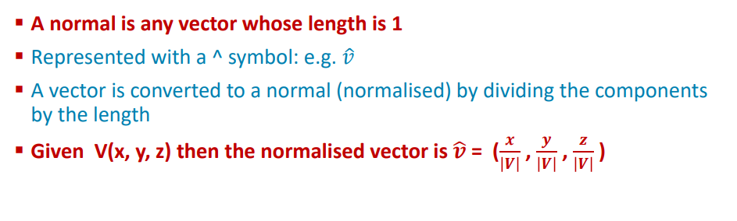
Recall: normalized vector

Slide 9
Part 2:
Collisions in video games

Slide 10
What does it mean for two objects to "collide" in a game world?
A collision occurs when two objects' boundaries overlap or touch.
These boundaries are simplified shapes (e.g., points, boxes, spheres, capsules)
The game checks whether these shapes intersect in space.
Collisions include physical contact (e.g., hitting a wall) and non-physical triggers (e.g., entering a pickup zone)
As a result, any interaction based on overlapping spaces is considered a collision

Slide 11
How does the game know that two objects have collided?
The game knows if two (or more) objects are colliding through a continuous process called “collision detection”
In collision detection, the engine checks if two (or more) bounding shapes overlap at each frame or time step.
To do that, the engine uses mathematical tests on simple shapes

Slide 12
So, what is collision detection?
Collision detection is the computational process of determining when two or more objects in a game world intersect, touch, or come close enough to be considered interacting.
It is a fundamental component of game physics and gameplay logic.
In simple terms, collision detection determines whether two objects are hitting each other.
This enables nearly every dynamic behavior in games, including: 1) bullets hitting enemies, 2) players collecting coins, 3) players bumping into walls, 4) vehicles crashing, and 5) objects stacking realistically, among many others.

Slide 13
What happens after a collision is detected?
The engine triggers a collision response/resolution to decide the outcome.
Examples of collision response/resolution:
    Stop the movement (e.g., preventing walking through walls, etc.)
    Apply physics effects (e.g., bounce, apply a force, apply friction, etc.)
    Trigger gameplay events (e.g., take damage, collect items, open doors, etc.)
    Among many others…

Slide 14
Part 3: types of collision detection

Slide 15
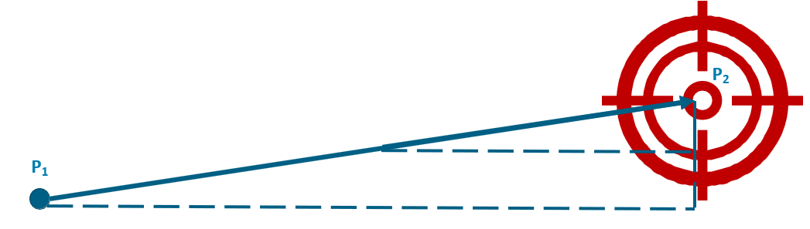
TYPE 1:
POINT TO POINT
The collision between two points is called a “point-to-point” collision
This is the simplest form of collision detection, and it is used to check whether a single point in space collides or occupies the same position as another point in space.
In that case, we are checking whether a single coordinate is the same for two objects.
To do that: remember that game objects move frame-by-frame and therefore, the distance between 2 objects is calculated each frame (i.e., the vector between 2 points).

Slide 16
TYPE 1:
POINT TO POINT (CONT.)
function pointToPointCollision (pointA, pointB, threshold):
// Calculate distance between the two points
dx = pointA.x - pointB.x
dy = pointA.y - pointB.y
dz = pointA.z - pointB.z
distanceSquared = dx*dx + dy*dy + dz*dz
// Compare distance to threshold (to avoid precision problems)
if distanceSquared <= threshold * threshold:
return true // Collision detected
else:
return false // No collision

Slide 17


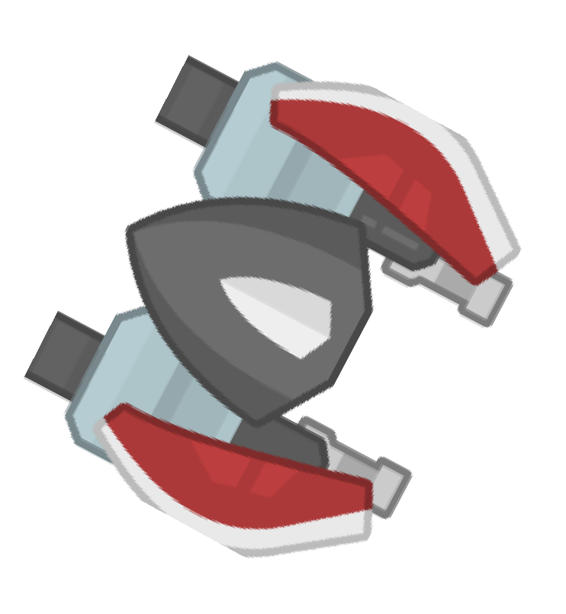


TYPE 1:
POINT TO POINT (cont.)
However, it is very unlikely that this type is utilized in games.
This is because:
    Perfect coordinate matching almost never happens in real-time games due to movement, floating-point precision, and continuous motion, making point-to-point collisions impractical for reliable gameplay detection.
    Most game objects have size and volume, so representing them as single points is unrealistic and cannot capture their shape or physical boundaries.

Slide 18
Bounding volumes
Calculating collisions using the full detailed shape of a model is too slow and complex, so bounding volumes provide a simpler way to detect collisions efficiently.
Bounding volumes are simple geometric shapes (like boxes, spheres, or capsules) used to approximate the shape of complex 2D/3D objects.
They allow the game engine to perform fast, efficient collision checks without relying on high-polygon meshes.
As a result, they act as a collision envelope, defining the area within which collisions are tested.
They help optimize performance by reducing the computational cost of physics and interaction checks.

Slide 19

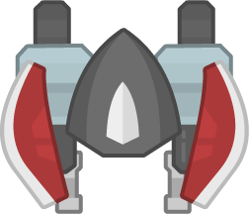


BOUNDING VOLUMES (CONT.)
Complex objects
Bounding volumes

Slide 20
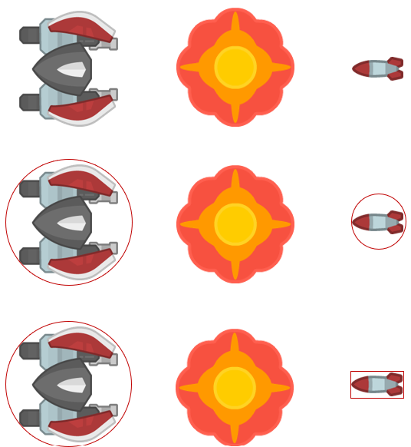
BOUNDING VOLUMES (CONT.)
Bounding volumes should fit as close as possible.
Spheres and boxes are two commonly used shapes.
The technique sacrifices precision for efficiency (speed) – an issue which crops up frequently in game programming.

Slide 21
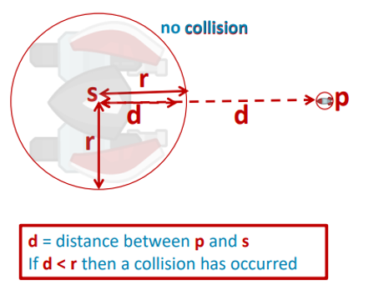
TYPE 2:
POINT TO SPHERE
The second type of collisions is “point to sphere”.
Point to sphere collision, checks whether a point “touches” or is inside a sphere.
In this type of collision, the collision occurs when the distance from the point to the center is smaller than the radius of the sphere.
Common uses:
    Detecting projectile hits
    Proximity checks in 3D space

Slide 22
Type 2: point to sphere (CONT.)
function pointToSphereCollision (point, sphereCenter, radius):
// Calculate distance between the point and the sphere center
dx = point.x - sphereCenter.x
dy = point.y - sphereCenter.y
dz = point.z - sphereCenter.z
distanceSquared = dx*dx + dy*dy + dz*dz
// Check if the point is inside or on the sphere
if distanceSquared <= radius * radius:
return true // Collision detected
else:
return false // No collision

Slide 23
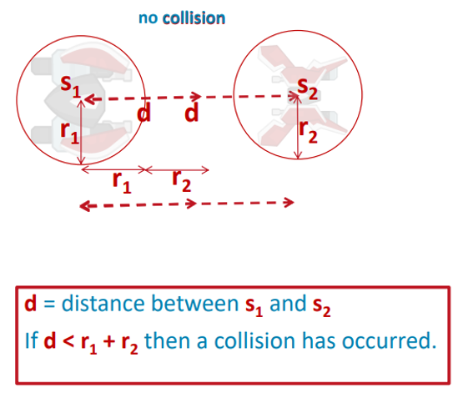
Type 3: sphere to sphere
The third type of collision is “Sphere to Sphere”.
Sphere to Sphere collision checks if two spheres are “touching”
To use Sphere to Sphere:
    Surround both objects with close-fitting spheres.
    Calculate the distance from the center of the first sphere to the center of the second sphere.
    If the distance is smaller than the sum of the sphere radii, then a collision has occurred.

Slide 24
Type 3: sphere to sphere (CONT.)
function sphereToSphereCollision (centerA, radiusA, centerB, radiusB):
// Calculate distance between the two sphere centers
dx = centerA.x - centerB.x
dy = centerA.y - centerB.y
dz = centerA.z - centerB.z
distanceSquared = dx*dx + dy*dy + dz*dz
radiusSum = radiusA + radiusB
// Check if spheres intersect
if distanceSquared <= radiusSum * radiusSum:
return true // Collision detected
else:
return false // No collision

Slide 25
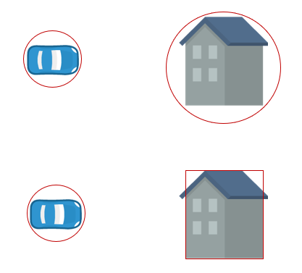
MORE ON BOUNDING VOLUMES
Spheres are useful because the math is comparatively simple - it's just an extension of vector calculations.
Spheres suit for some objects (e.g.) people
But spheres do not suit all objects (e.g.) a crate or a house.
In these cases, a box (cuboid) would be a more appropriate approximation.
This approach is known as a Bounding Box.

Slide 26

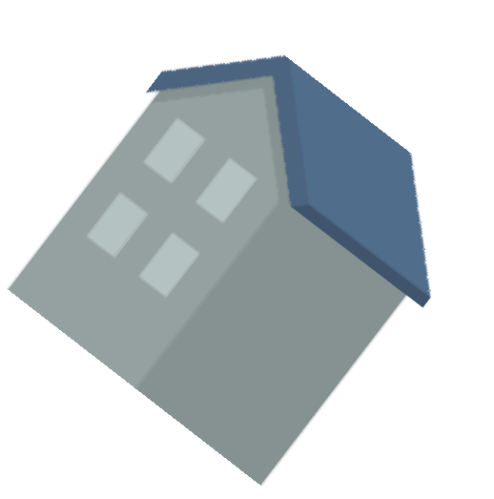
Bounding boxes
Y
A bounding box is a simple geometric box (usually rectangular or cuboid) that encloses an object to approximate its shape for collision detection
Types:
    Axis-Aligned Bounding Box (AABB): Always aligned with the world axes; does not rotate with the object.
    Oriented Bounding Box (OBB): Rotates with the object; better fits the object’s orientation but is more computationally expensive
X

Slide 27
Bounding boxes (cont.)
The simplest form of bounding boxes is the “AABB”
This is because a box that is not axis-aligned will be more difficult to use, as problems will arise if an object can rotate.
Boxes better suit objects that cannot rotate.
However, it is also possible to do the calculations for a non-axis-aligned bounding box.

Slide 28
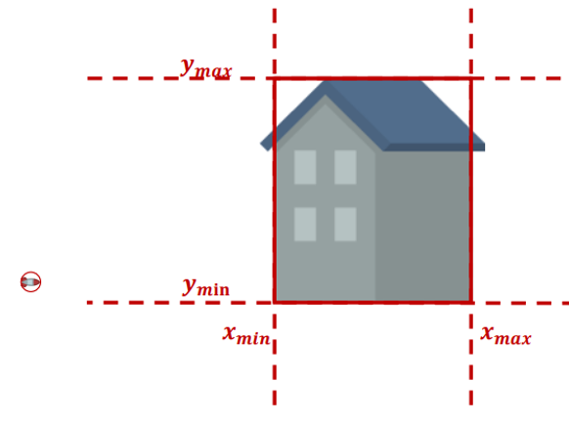
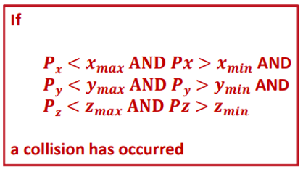
TYPE 4:
POINT TO BOX
The fourth type of collision is “point to box”
A box, usually an AABB, is defined by its minimum and maximum coordinates along each axis
To check for a collision, we need to:
    Compare the point’s x, y, and z coordinates to the box’s min and max coordinates.
    If the point lies within all ranges, it is colliding with the box.

Slide 29
TYPE 4:
POINT TO BOX (cont.)
function pointToBoxCollision (point, boxMin, boxMax):
if point.x >= boxMin.x and point.x <= boxMax.x and
point.y >= boxMin.y and point.y <= boxMax.y and
point.z >= boxMin.z and point.z <= boxMax.z:
return true // Collision detected
else:
return false // No collision

Slide 30
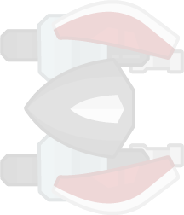

Type 5: sphere to box
The fifth type of collision is “Sphere to Box”
This type of collision checks if a sphere “touches” a box and vice versa
The sphere is defined by its center position and radius
The box is defined by its min and max coordinates
To check for collision:
    Find the closest point on the box to the sphere’s center
    Calculate the distance between the closest point and the sphere’s center
    If the distance is smaller than the sphere radius, then a collision is detected.

Slide 31
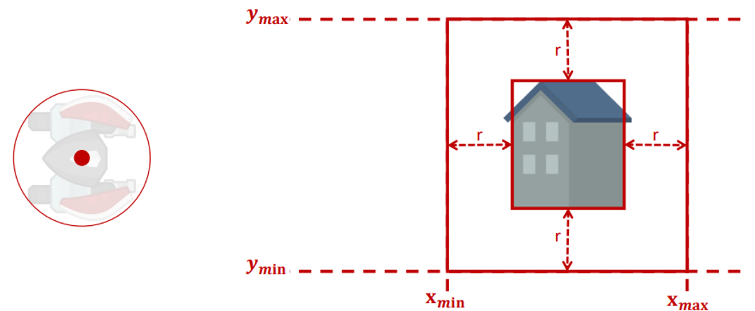
Type 5: sphere to box (CONT.)
In other words, this is the same method as the point to box, but…
    we add the radius to the maximum x, y, and z values of the box, and then subtract it from the minimum x, y, and z values.
However, keep in mind that this method can be inaccurate in the corners of the box.

Slide 32
Type 5: sphere to box (CONT.)
function sphereToBoxCollision(sphereCenter, radius, boxMin, boxMax):
// Find the closest point on the box to the sphere center
closestX = clamp(sphereCenter.x, boxMin.x, boxMax.x)
closestY = clamp(sphereCenter.y, boxMin.y, boxMax.y)
closestZ = clamp(sphereCenter.z, boxMin.z, boxMax.z)
// Calculate distance squared between sphere center and closest point
dx = sphereCenter.x - closestX
dy = sphereCenter.y - closestY
dz = sphereCenter.z - closestZ
distanceSquared = dx*dx + dy*dy + dz*dz
if distanceSquared <= radius * radius:
return true // Collision detected
else:
return false // No collision

Slide 33
More types of collision detection
These are some of the fundamental types of collisions
These represent the building blocks for most collision detection in games
They are important as 1) they are easy to compute, 2) serve as approximations for complex shapes, and 3) provide the foundation for collision algorithms in physics engines.
However, there are more complicated types of collisions which for now, you don’t need to know them, but it is good to be aware of them:
    Box to Box (AABB or OBB VS OBB)
    Mesh to Mesh (Triangle-level collisions)
    Capsule to Capsule (common in character-to-character collision detection)

Slide 34
Part 4: collision RESOLUTION

Slide 35
Collision Resolution
However, just identifying that a collision happens in our games does not have any effect on our games.
This is because collisions are only telling us that two objects are “touching”
To make this information useful, we need to implement a collision resolution.
Collision Resolution is the process of deciding how objects respond after a collision
It should ensure objects behave realistically and according to game rules.
This effectively transforms a collision detection (“yes/no”) into a meaningful game reaction

Slide 36
Examples of
Collision resolution
Stop movement: Prevents objects from passing through each other.
Bounce/reflect: Objects rebound after impact.
Trigger events: Collect items, open doors, deal damage.
Apply forces: Push objects apart in physics simulations.
Among many other examples….

Slide 37
SUMMARY
Collision detection is a common operation in games to determine whether two objects in a game have come into contact.
There are multiple types of collisions:
    Point to Point, Point to Sphere, Sphere to Sphere, Point to Box, Sphere to Box, among others.
It is time-consuming and mathematically complex to test whether two complex objects intersect; therefore, bounding volumes and boxes are used.
This approach sacrifices precision for speed.
After a collision is detected, it should be resolved.

Slide 38
QUESTIONS?!

